Slide 1


Natural Language Processing (NLP)
Hotel Review Classification
Mentor : Mr. Adhvaith
Team Members
Mr. Aman Goutam
Mr. Mimoh Raj
Mr Vinay Kumar C
Mr.Mysore Veerendra Chary
Mr.Gourab Mishra

Slide 2
Contents
Objective
EDA
Visualisation
Text Preprocessing
N gram Analysis
Word Cloud
Sentiment analysis using (VADER)
Named Entity Recognition
Model Building
Deployment using Streamlit

Slide 3
Objective
What are the attributes that travellers are considering while selecting a hotel. With this manager can understand which elements of their hotel influence more in forming a positive review or improves hotel brand image.

Slide 4
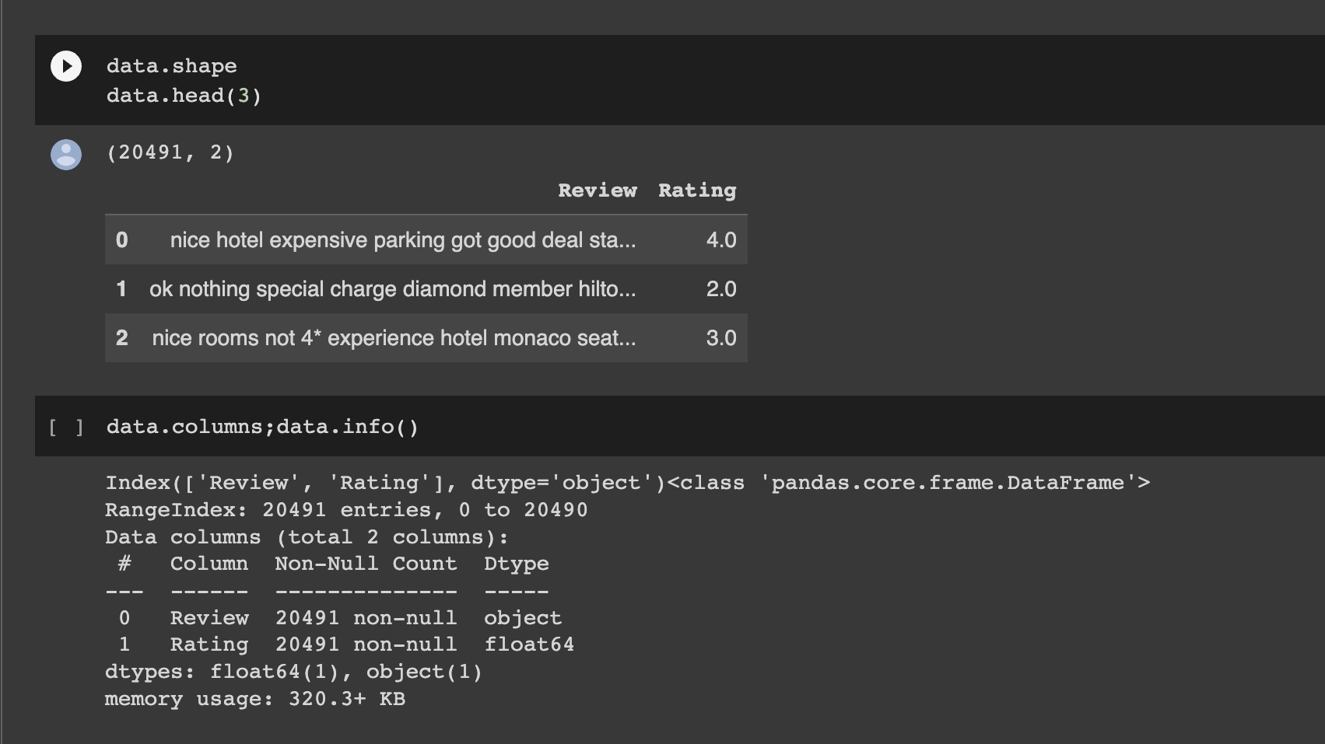
EDA(Exploratory Data Analysis)

Slide 5
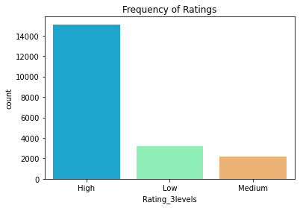
Visualization in EDA
Count plot shows from seaborn library for observing the maximum rating

Slide 6
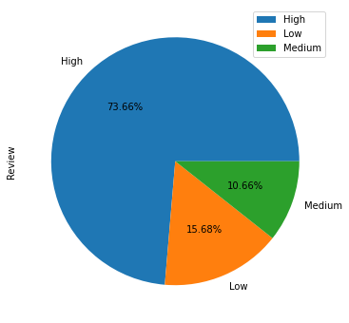
Pie Chart using Group By Function

Slide 7
Text Preprocessing
Normalizing the data
To remove both the leading and the trailing characters
To remove empty strings
Joining the list into one string/text
Removing Punctuations
Tokenization / Removing stopwords / Lemmatization / Stemming
Joining the data
Named Entity Recognition (NER)

Slide 8
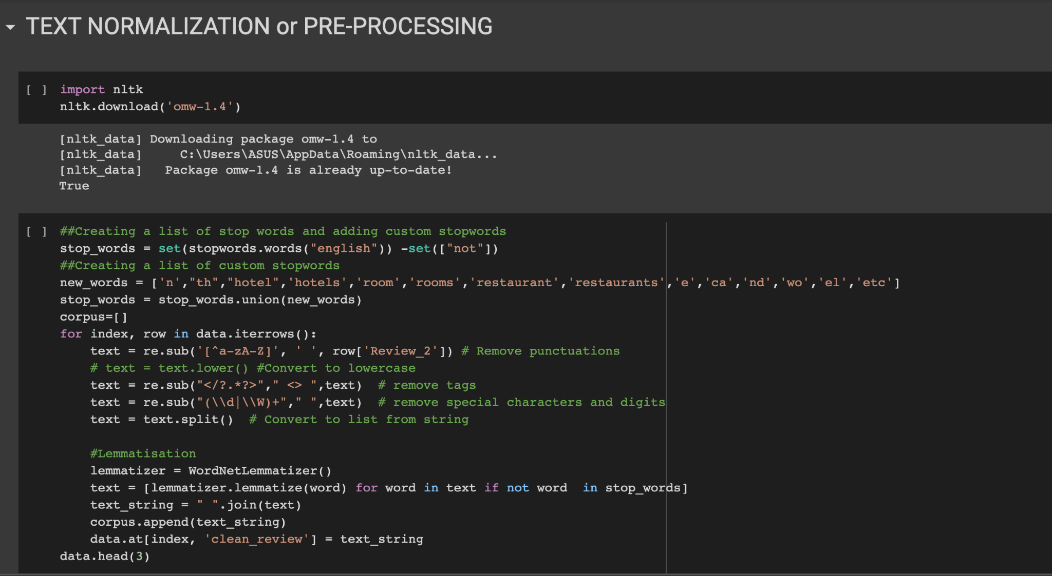

Slide 9
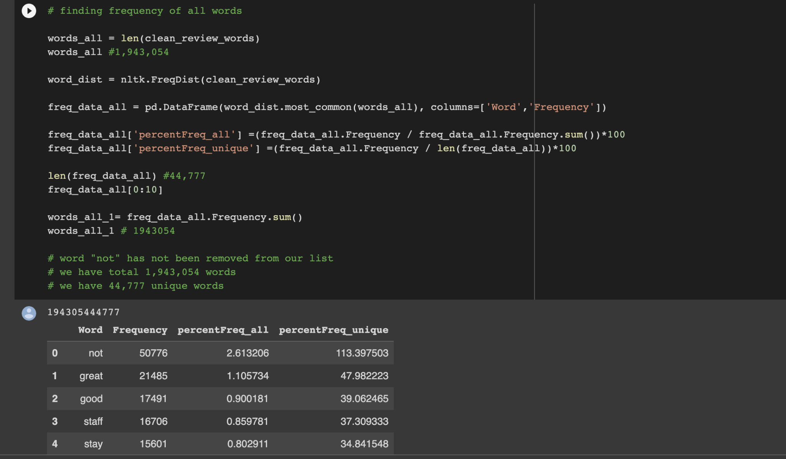
Finding The Frequency of all words

Slide 10
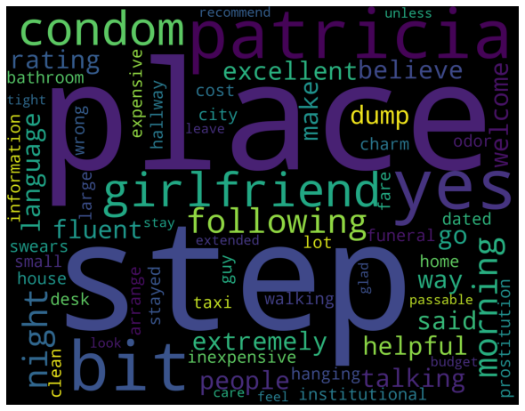
Word Cloud
word cloud is the visualization of the most frequent words from text

Slide 11
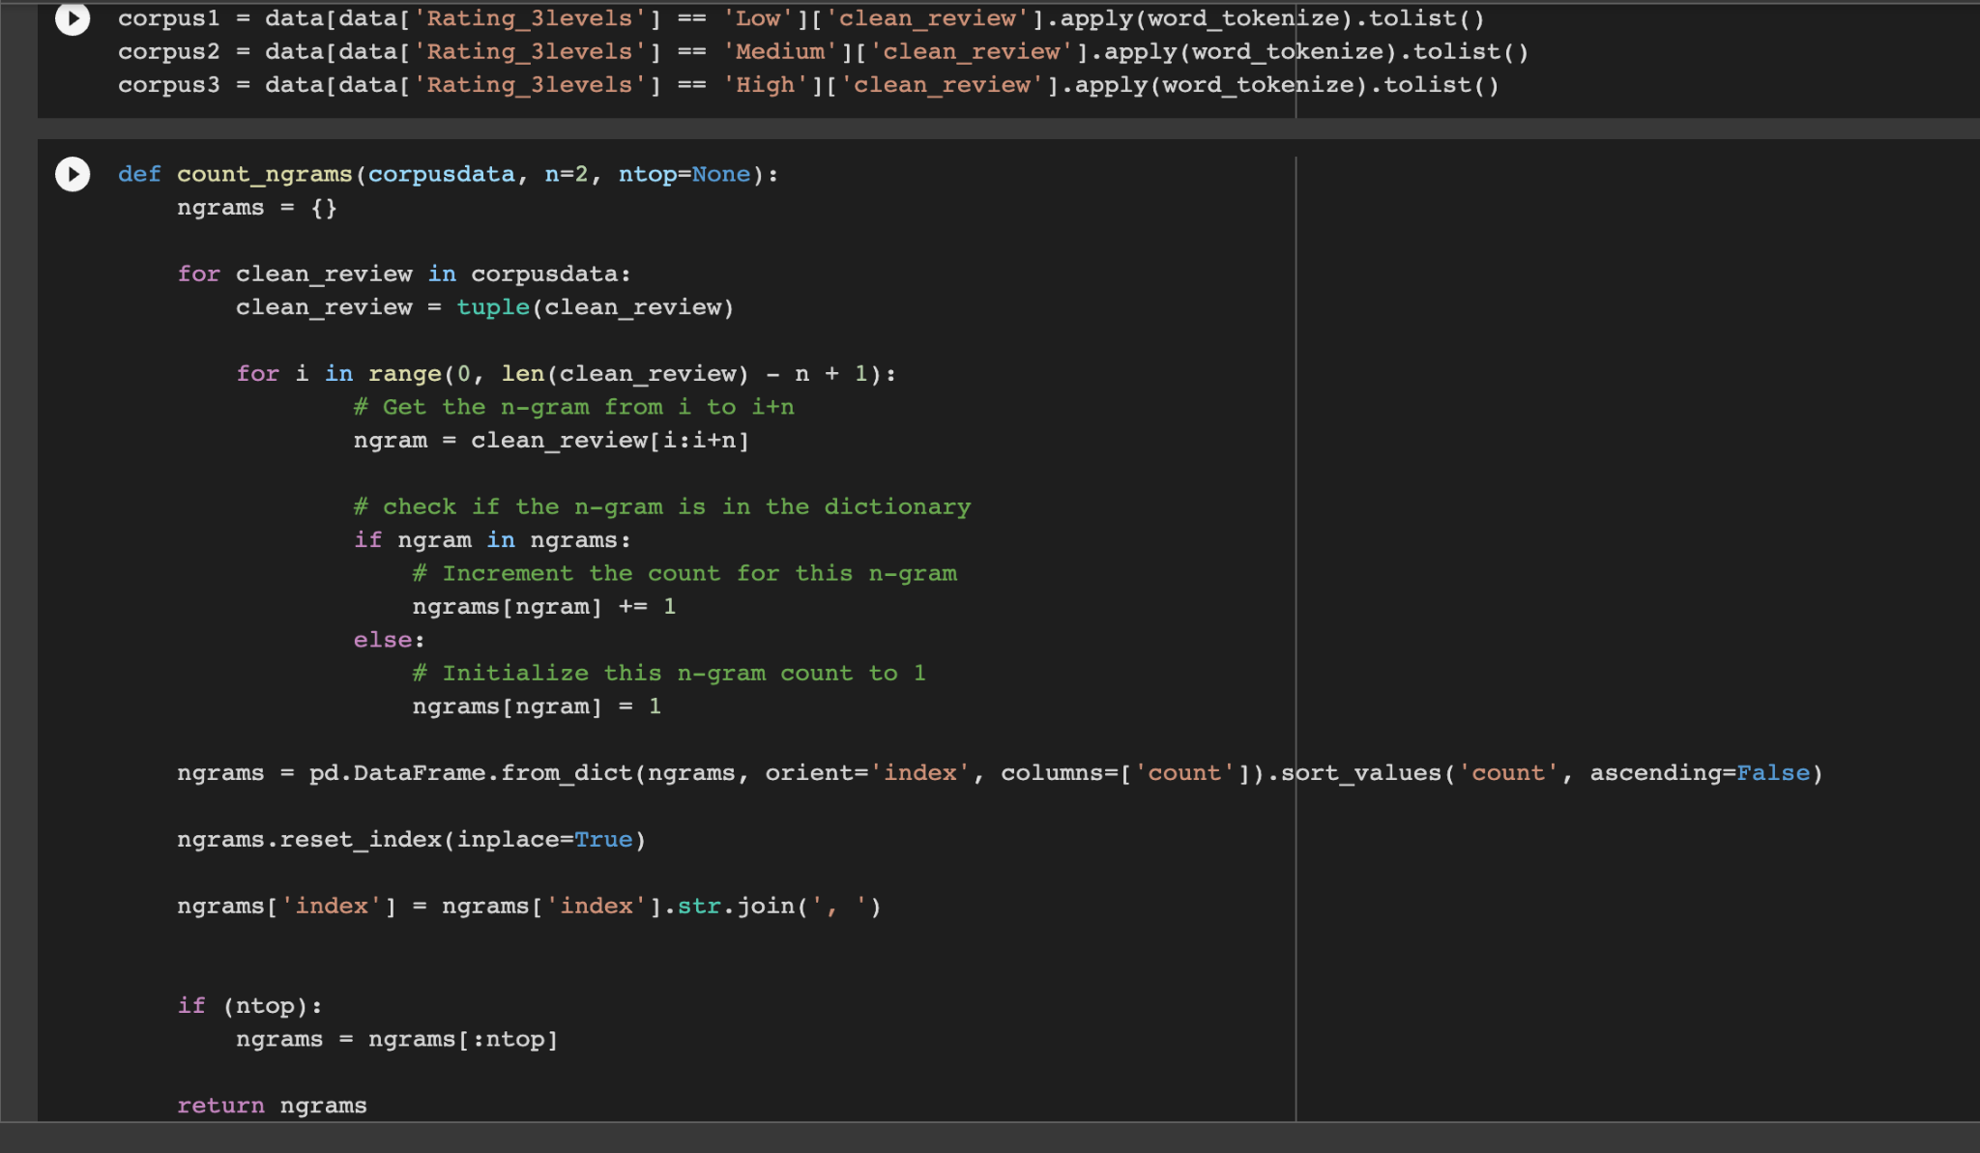
N Gram Analysis

Slide 12
Sentiment Analysis using(VADER)
VADER is a less resource-consuming sentiment analysis model that uses a set of rules to specify a mathematical model without explicitly coding it. VADER consumes fewer resources as compared to Machine Learning models as there is no need for vast amounts of training data.
VADER’s resource-efficient approach helps us to decode and quantify the emotions contained in streaming media such as text, audio or video. VADER doesn’t suffer severely from a speed-performance tradeoff.
The Compound score is a metric that calculates the sum of all the lexicon ratings which have been normalized between -1(most extreme negative) and +1 (most extreme positive).
positive sentiment : (compound score >= 0.05)
neutral sentiment : (compound score > -0.05) and (compound score < 0.05)
negative sentiment : (compound score <= -0.05)

Slide 13
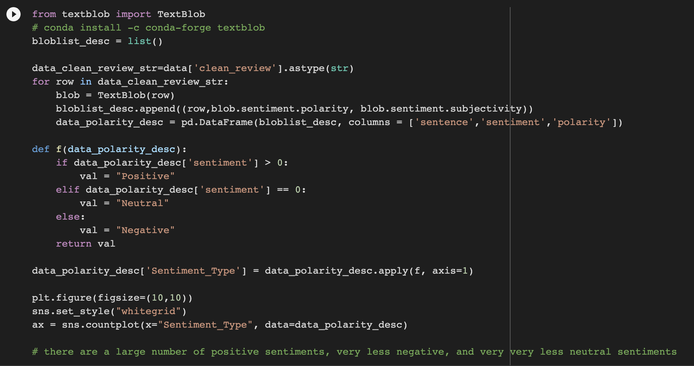
Sentiment Analysis using(VADER)

Slide 14
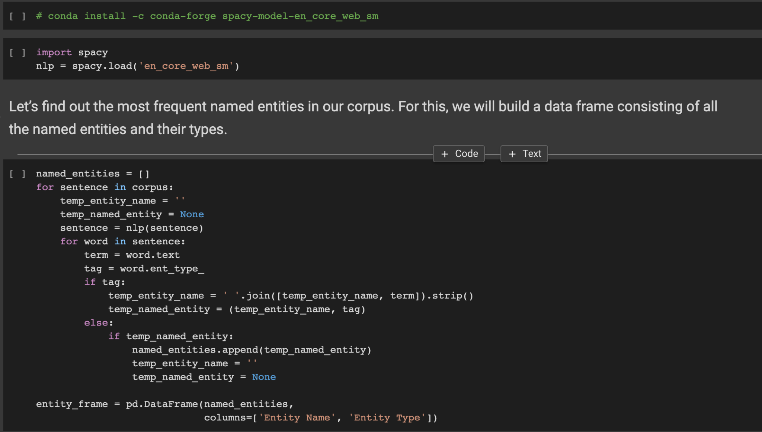
Named Entity Recognition

Slide 15
Model Building
In model building 1st step is we split our data into training part and testing part . On training data we use machine learning algorithms and train the model for drawing insights from the data and this model we later apply on testing data to check if our model giving right insights or not
MODEL USED
SVM
RANDOM FOREST
DECISION TREE
MULTINOMIAL NAIVE BAYES
K- NEIGHBORS CLASSIFIER
LOGISTIC REGRESSION

Slide 16
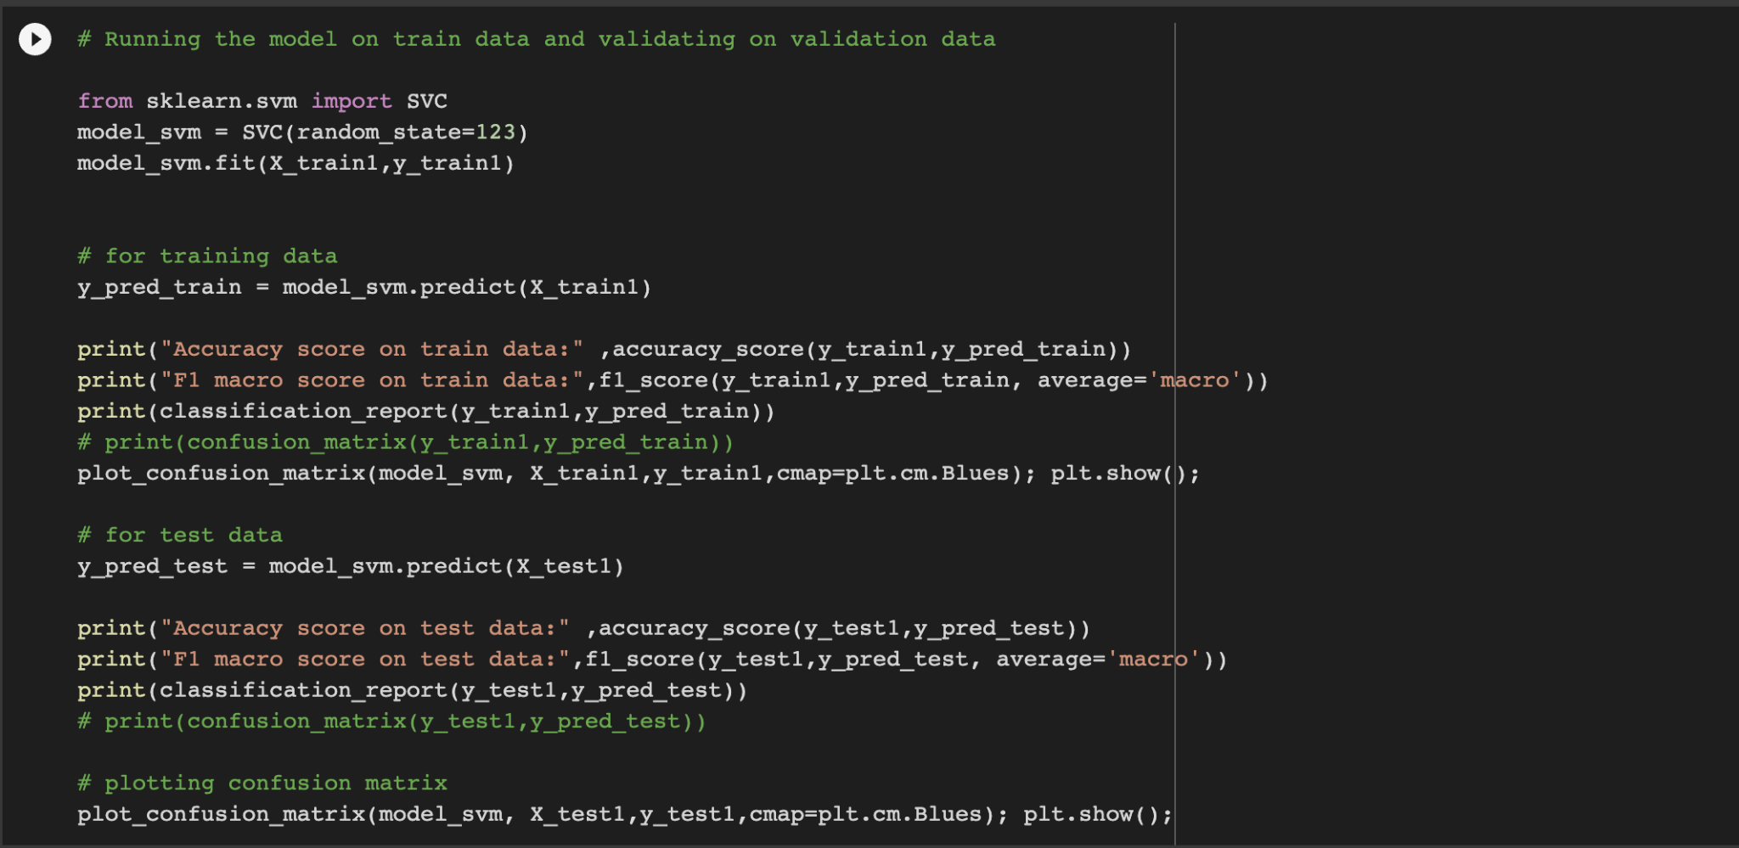
SVM
Accuracy score on train data: 0.966447047340166
Accuracy score on test data: 0.8631373505733105

Slide 17
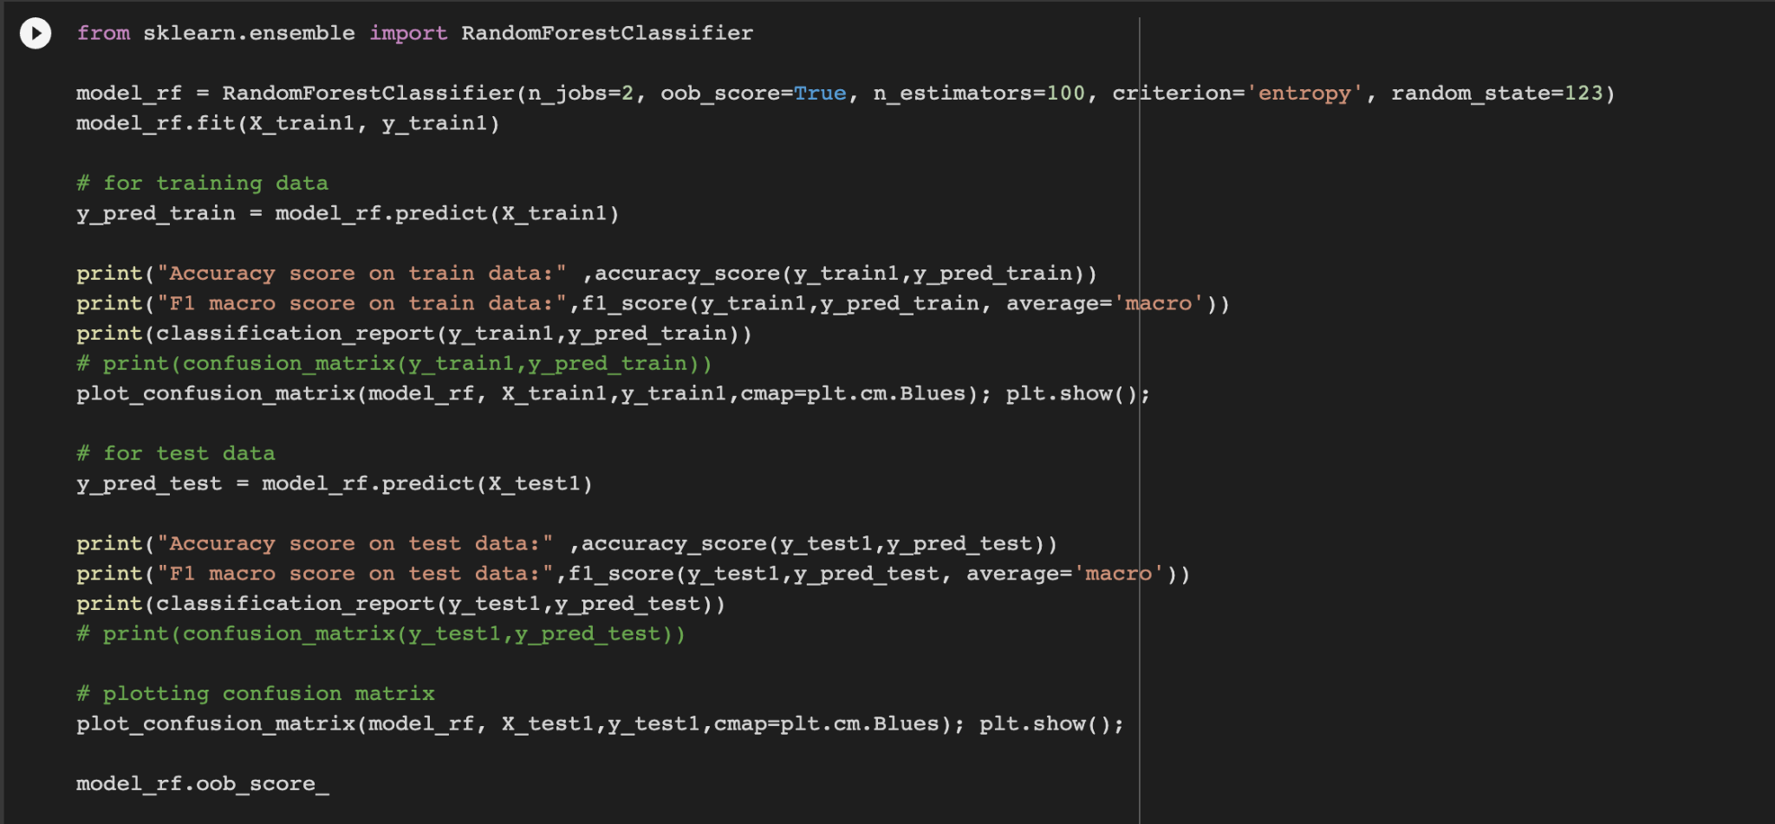
Random Forest
Accuracy score on train data: 1.0
Accuracy score on test data: 0.8160526957794584

Slide 18
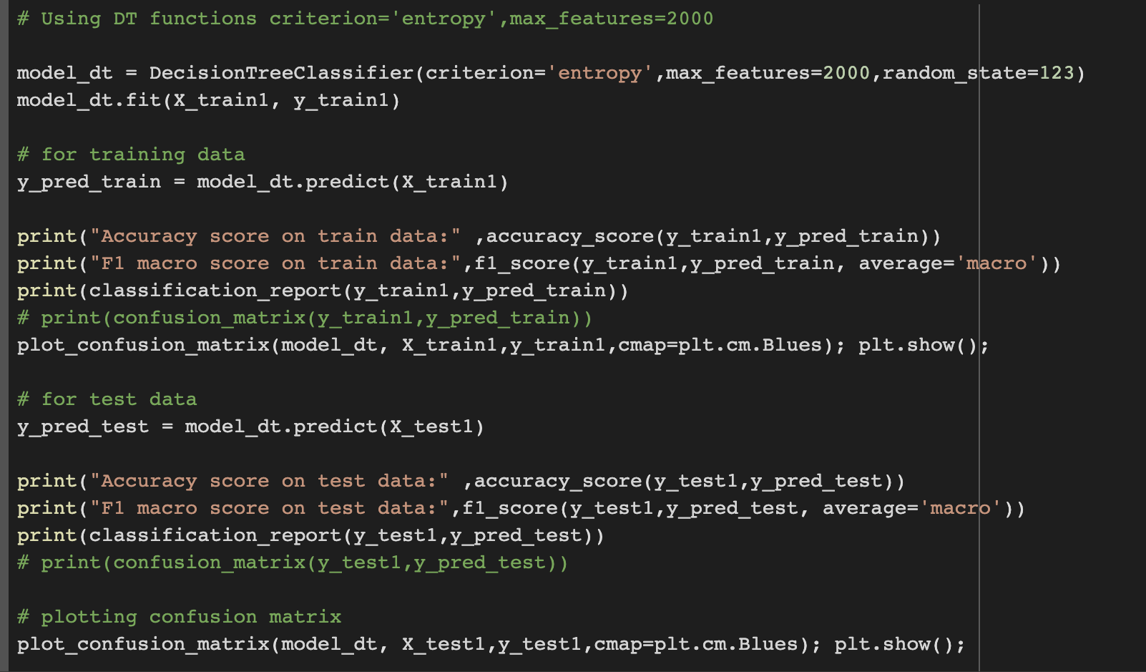
Decision Tree
Accuracy score on train data: 1.0
Accuracy score on test data: 0.7277384727982434

Slide 19
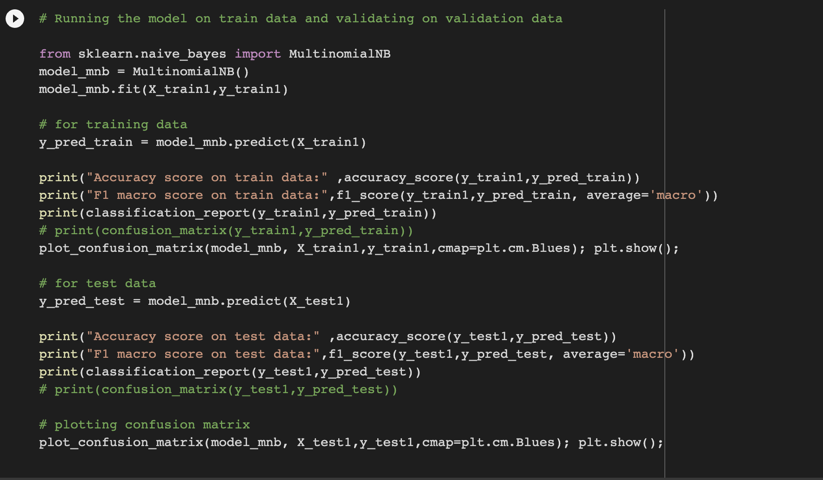
Multinomial Naive Bayes
Accuracy score on train data: 0.8318081991215227
Accuracy score on test data: 0.8250792876311296

Slide 20
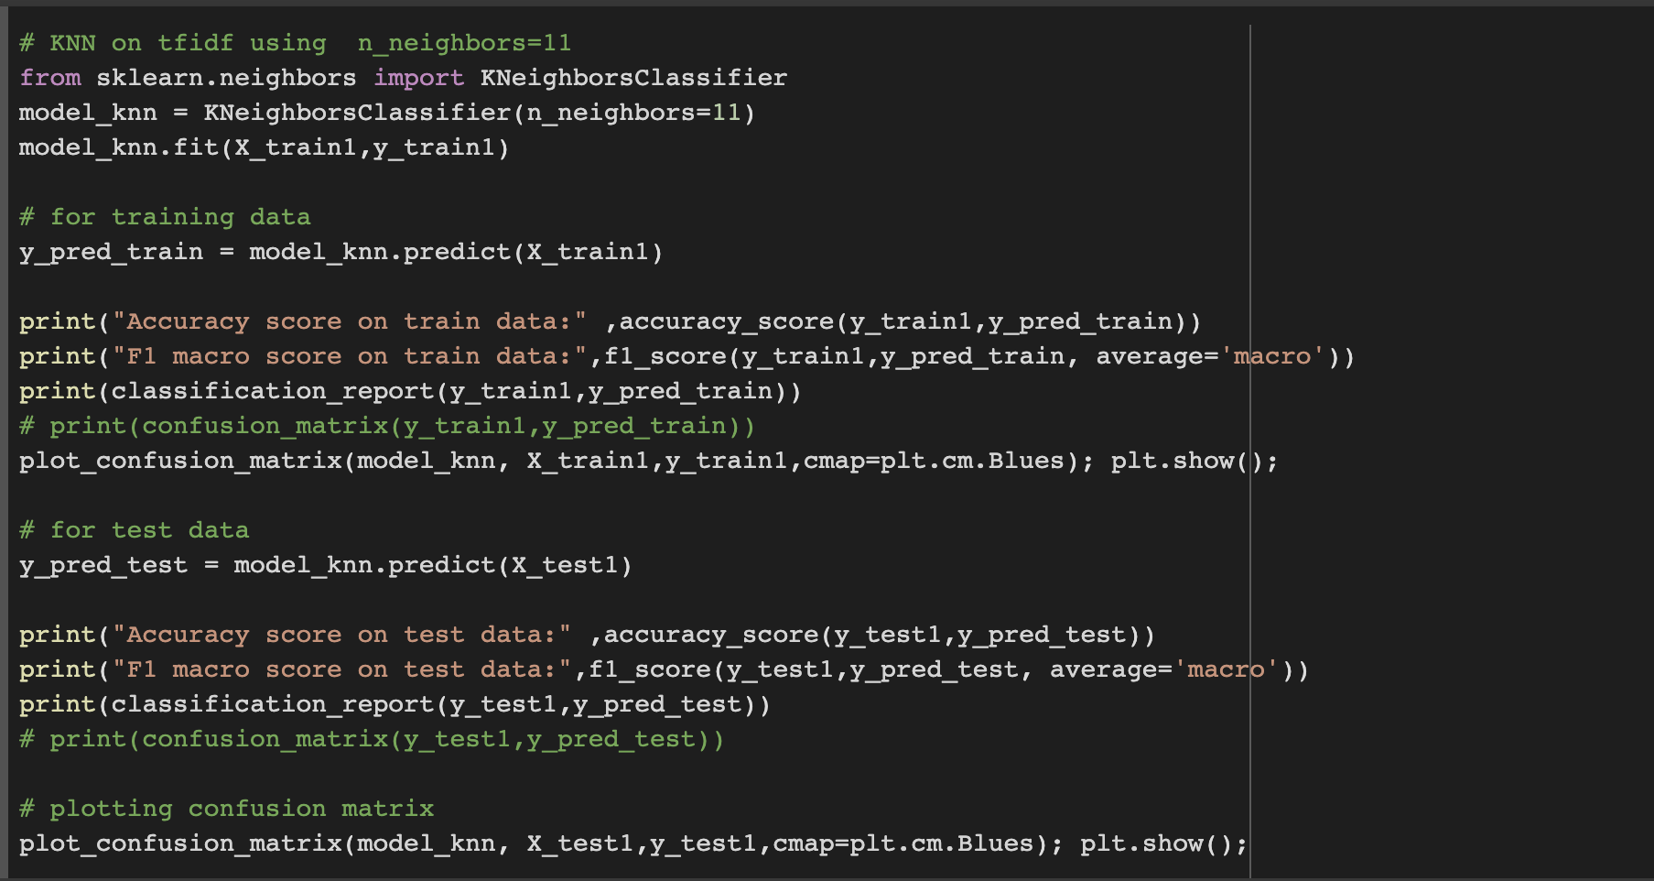
K Neighbors Classifier
Accuracy score on train data: 0.8117984382625671
Accuracy score on test data: 0.7977555501341791

Slide 21
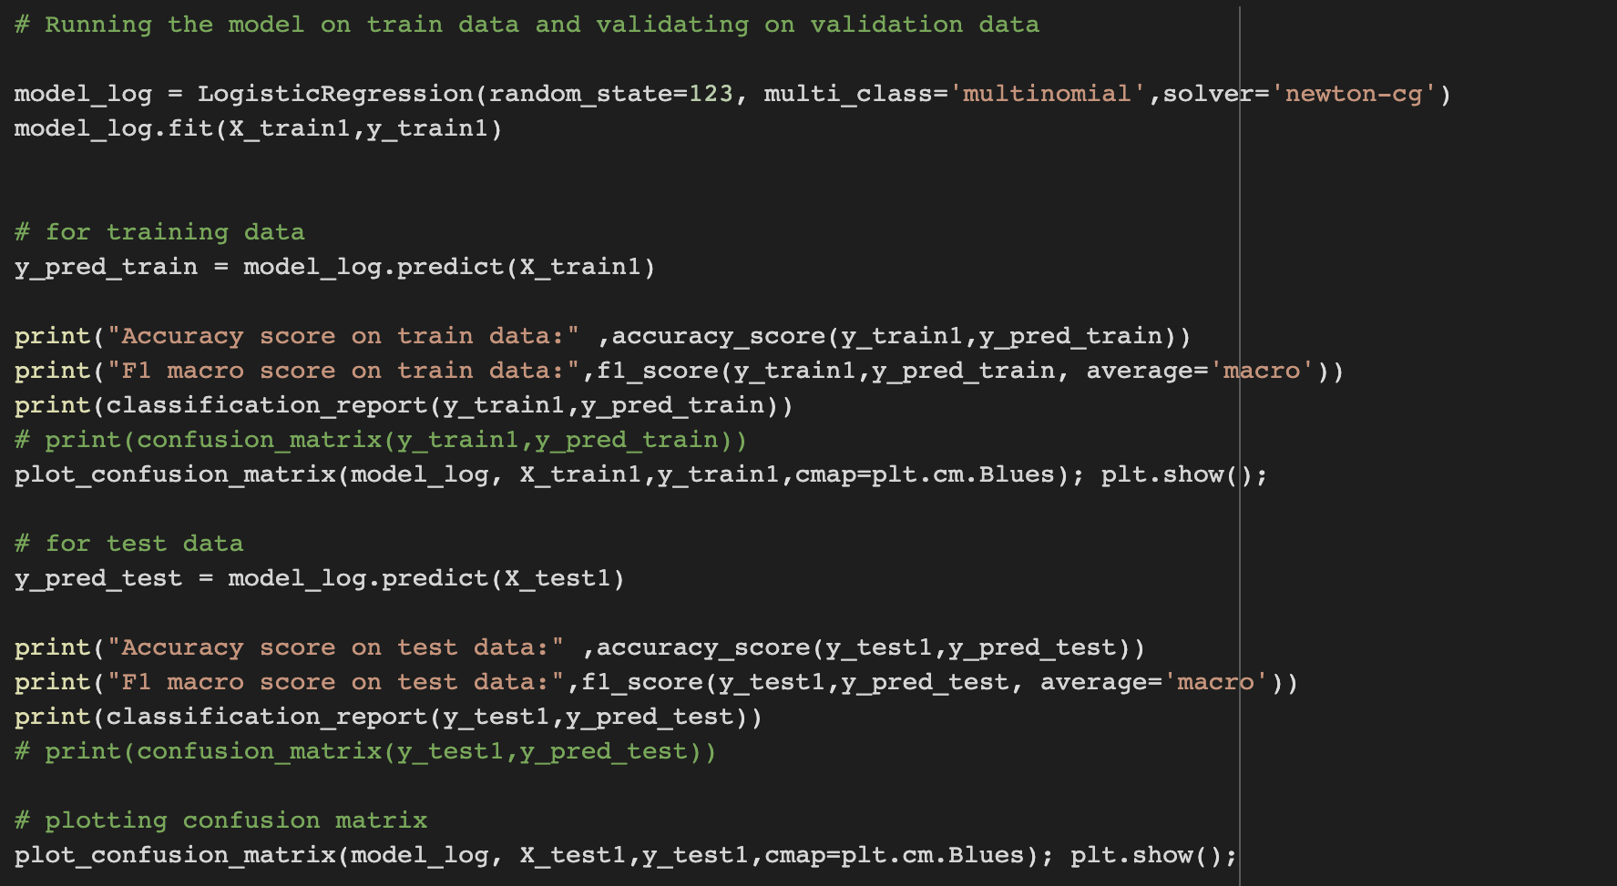
Logistic Regression
Accuracy score on train data: 0.8980600292825769
Accuracy score on test data: 0.8633813125152476

Slide 22
Final Model
Logistic regression model is giving a good training and testing accuracies and better stability ,so we are finalizing logistic model as our final model.

Slide 23
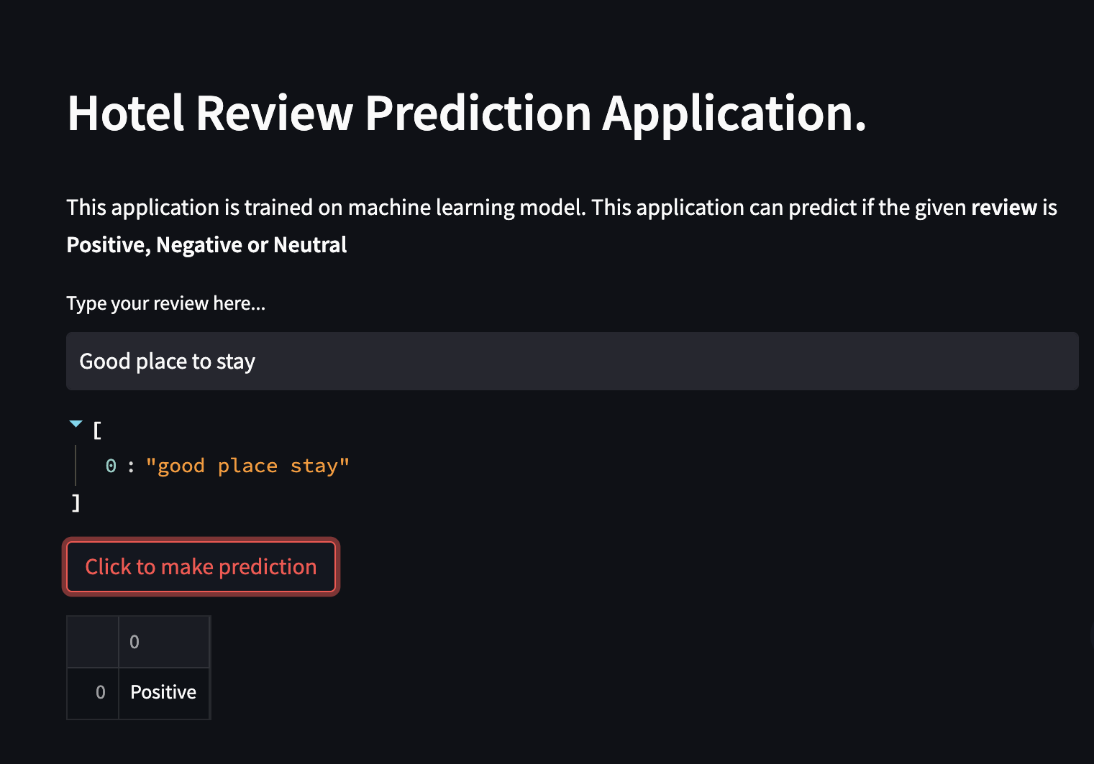
Deployment

Slide 24
THANK YOU

